Slide 1
Final Report on the Change Point Problem posed by Mapleridge Capital Corporation
Friday Dec 11 2009

Slide 2
Group members
Students/Postdocs: Bobby Pourziaei (York), Lifeng Chen (York) Jing (Crystal) Zhao (CUHK)
Industrial Delegates: Yunchuan Gao & Randal Selkirk (Mapleridge Capital)
Faculty Advisors: Matt Davison (Western), Sebastian Jaimungal (Toronto), Lu Liqiang (Fudan) Huaxiong Huang (York)

Slide 3
The Change Point Problem
Where, if anywhere, is the change point in this time series?

Slide 4
Question too vague
Existence of and location for change points depends!
For instance, in a model for stock returns dln(St) = (μ-0.5σ²)dt + σdWt, a change in observed volatility might indicate a change point.
But, if the return model has a stochastic volatility, what was previously a change point might now be explained within the model.

Slide 5
Mapleridge Questions
In a Hidden Markov Model of market data, how many states are best?
In a given sample, what is the number of change points?
How can we modify the HMM idea to produce non-geometric duration time distributions?

Slide 6
Threefold approach
“Econometric” approach using Least Squares
Wavelet based change point detection (solution to problem 2)
Bayesian Online Changepoint detection algorithm (A solution to problems 1 and 3?)

Slide 7
Wavelet based change point detection
Convolve wavelet with entire dataset
With judicious choice of wavelet, change points appear.
These change points are consistent with those determined in the Bayesian Online approach described later.

Slide 8
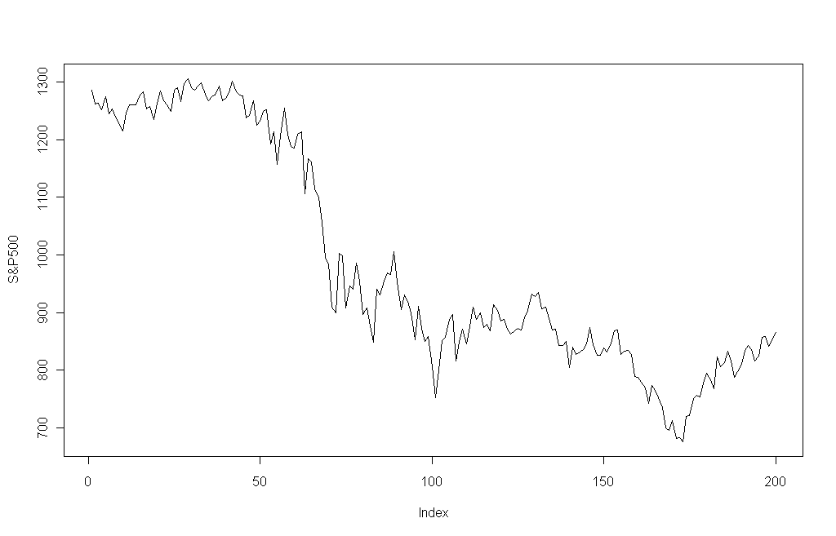
Structural Changes based on LS Regression
Data: Standard&Poors 500 Index (S&P500) over the period 1 July 2008 to 14 April 2009.(total: 200 trading days)
When Lehman Brothers and other important financial institutions failed in September 2008, the financial crisis hit a key point. During a two day period in September 2008, $150 billion were withdrawn from USA money fund.

Slide 9
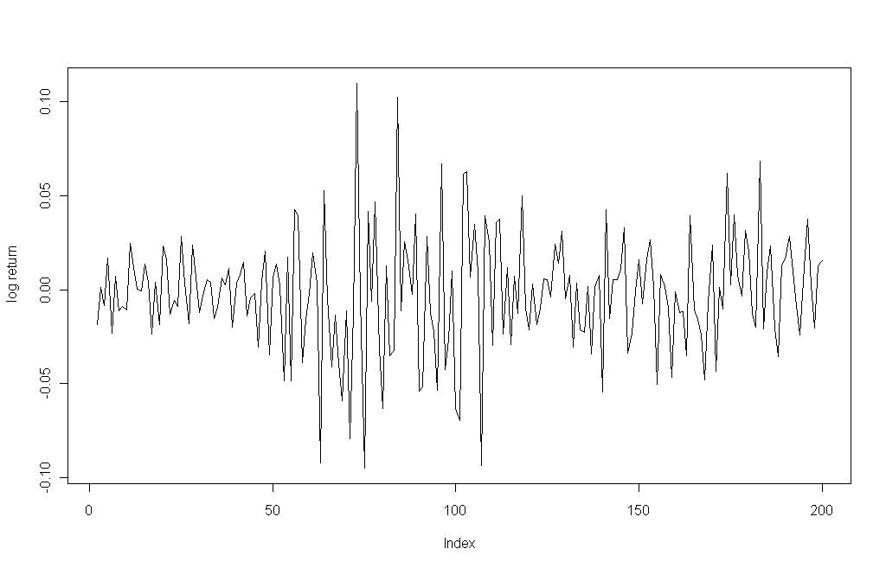
Structural Changes based on LS Regression
Transform the data into log-return
Target: detect multiple change points in financial market volatility dynamics, here consider the process of (log(return))^2

Slide 10
The trajectory of the process often sheds light on the type of deviation from the null hypothesis such as the dating of the structural breaks.
OLS-based CUSUM test detects September of 2008 as the suspicious region involving change points. (Similarly for OLS-based MOSUM)

Slide 11
Structural Changes based on LS Regression
2. Dating structural changes
Given an m-partition, the LS estimates can easily be obtained.
The problem of dating structural changes is to find the change points that minimize the objective function over all partitions.
These can be found much easier by a dynamic programming approach that is of order O(n²) for any number of changes m. (Bellman's principle)
Consider two criteria here, the residual sum of squares (RSS) and the Bayesian information criterion (BIC).

Slide 12
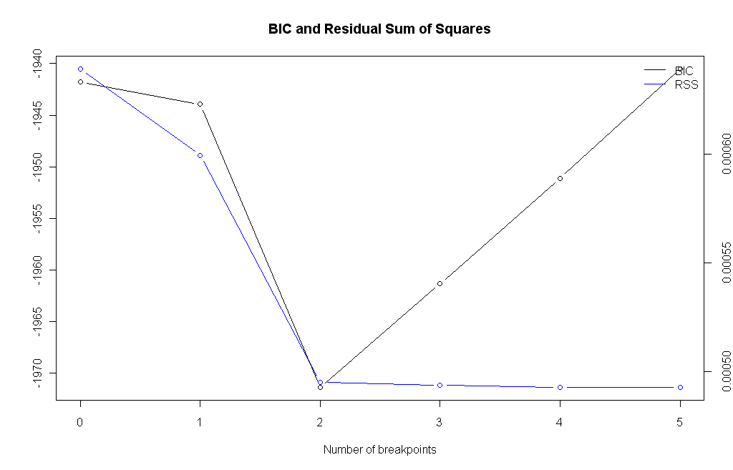
RSS? Vs. BIC suggests to choose two breakpoints.
The BIC resolves this problem by introducing a penalty term for the number of parameters in the model.

Slide 13
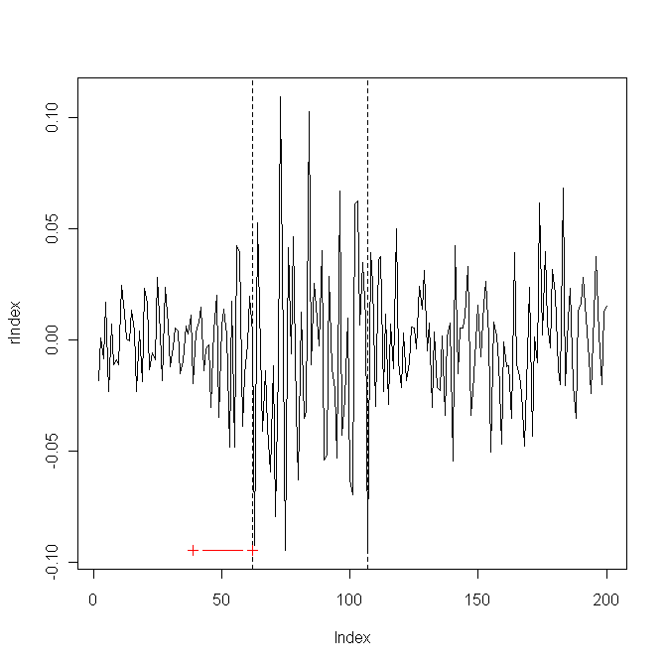
Results: Optimal 3-segment partition with breakpoints 61 (9/25/2008) and 106 (11/28/2008).
Confidence Intervals of the breakpoints
2.5 % breakpoints 97.5 %
38 (8/22/2008) 61 (9/25/2008) 62 (9/26/2008)
105 (11/26/2008) 106 (11/28/2008) 137 (1/14/2009)

Slide 14
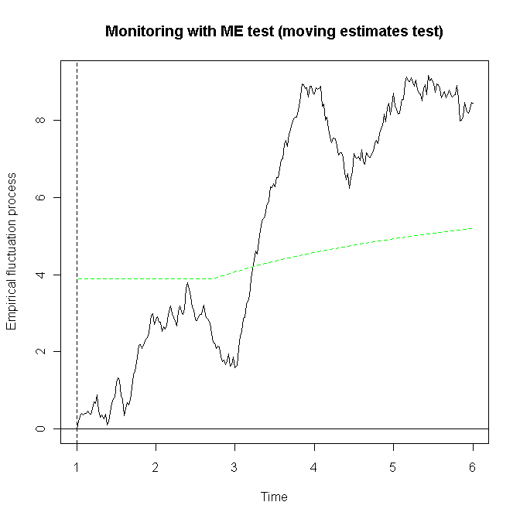
3.Online Monitoring structural changes
Given a stable model established for a period of observations, it is natural to ask whether this model remains stable for future incoming observations sequentially.
The empirical fluctuation process is simple continued in the monitoring period by computing the empirical estimating functions for each new observation (using the parameter estimates from the stable history period) and updating the cumulative sum process.
This is still governed by a Functional CLT from which stable boundaries can be computed that are crossed with only a given probability under the null hypothesis.

Slide 15
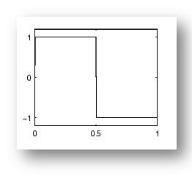
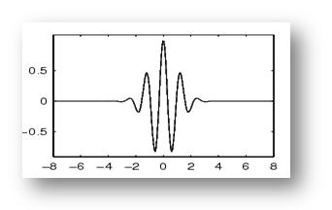
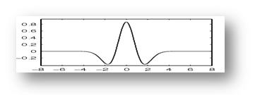
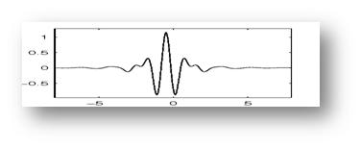
Wavelets
Mother Wavelet
Notes:
The procedure of using wavelet transforms starts with choosing a wavelet called a mother or parent wavelet.
There are many types of mother wavelets and each type has its own characteristics.

Slide 16
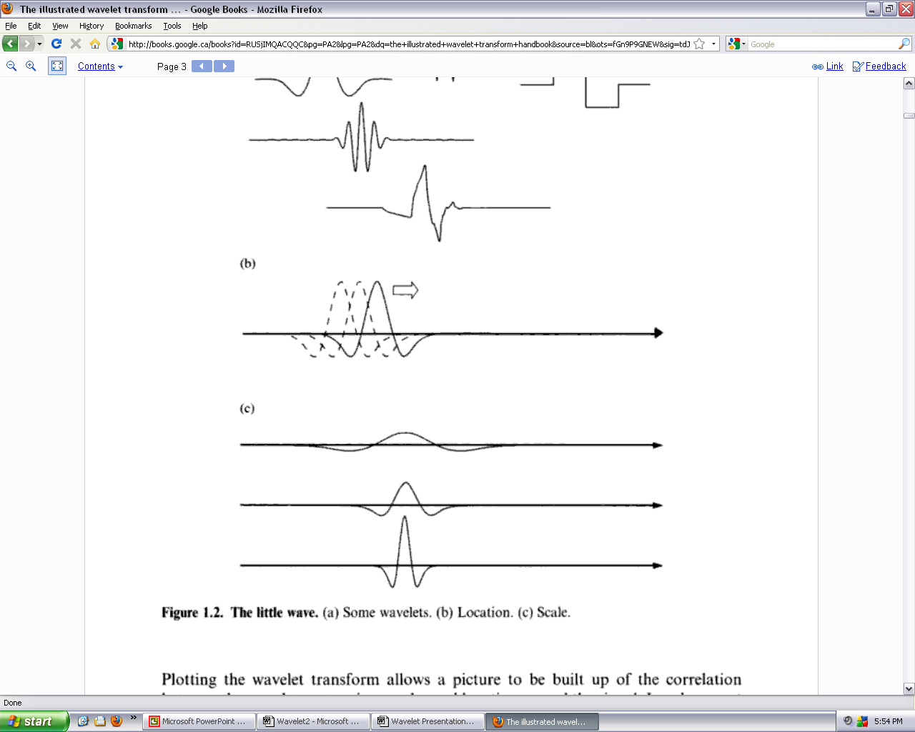

Wavelets
Notes:
Once an appropriate mother wavelet has been chosen, for a particular scale, it is translated through the signal using convolution.
The windowing technique scales the mother wavelet by either dilating or compressing it.
A compressed wavelet represents high frequency.
A dilated wavelet represents low frequency

Slide 17
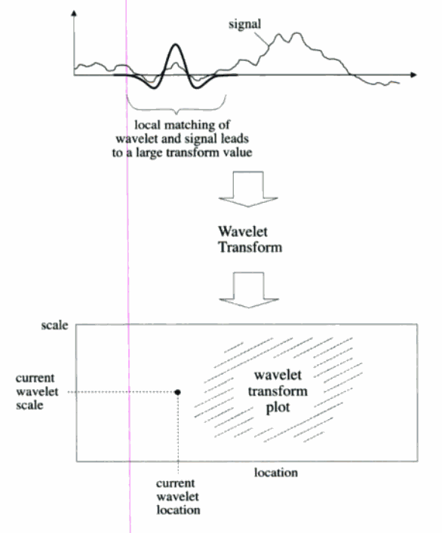
Wavelet
Notes:
The convolution of the mother wavelet and signal quantifies how well the mother wavelet correlates with the topology of the signal.
This correlation of the signal, receives a value of how well the mother wavelet matches the signal.
For the particular position in time if high correlation, the transform reports a high value
if no correlation it reports a low value
Record results using colour coded contour image.

Slide 18
Results – Data: sp500

Slide 19
Results – Data: sp500

Slide 20
Results – Data: sp500

Slide 21
Results – Data: es1

Slide 22
Results – Data: es1

Slide 23
Results – Data: es1

Slide 24
Testing Wavelets against Synthetic Data
Create 2500 entry dataset (Bob byData) with change point every 500 ticks
First 2000 normal with changing mean and variance across regimes
Last 500 beta distributed

Slide 25
Results – Data: BobbyData

Slide 26
Results – Data: BobbyData

Slide 27
green is sum of sq of wavelet coeff BobbyData

Slide 28
Results – Data: BobbyData

Slide 29
Wavelet Conclusions
Wavelet tool does find change points, but finds some that aren’t there.
Some agreement with least squares model on common dataset.
Two ‘flavours’ of testing – for mean and for variance changes.

Slide 30
Bayesian Online Changepoint Detection
“Bayesian Online Changepoint Detection” – R.P. Adams and D.J.C. MacKay.
Method defines run length R_{n} as length of time in current regime.
Computes posterior distribution of run length given data: P(R_{n}|x_{1..n})
Does not require number of regimes to be specified.

Slide 31
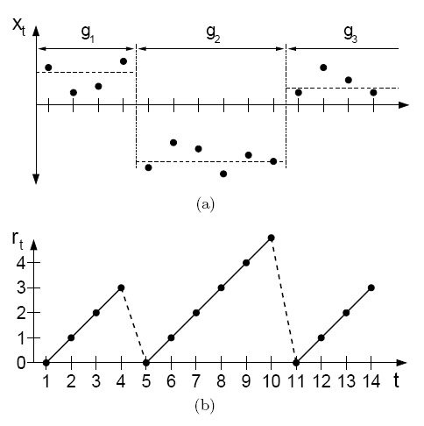
Run length

Slide 32
How the method works:
Intermediate computations require predictive distribution given a known run length:
P( x_{n} | R_{n}, x_{1..n-1} )
This requires a prior assumption on the distribution in a given regime
Results require domain specific knowledge for reasonable results
Hazard rate prior also required:
our code assumes constant hazard – i.e. memoryless property (geometric durations)

Slide 33
Prior specification
We model stock returns using simple Brownian motion, requiring 2 parameters
Obtain these parameters using conjugate priors: Normal (for mean)/ Inverse Gaussian (for volatility = standard deviation).
We standardize our data (using in-sample mean and standard deviation)
With this N(0,1) is a decent prior for the mean.

Slide 34
More about priors:
The inverse gamma distribution's pdf has support x > 0
Two parameters α (shape) and β (scale).
f(x;α,β) = β^{α}/Г(α)(1/x)^{α+1} exp(-β/x)
This has mean β/(α-1 ) and variance (β/α-1)²(1/α-2); mode β/(α+1)
From in sample data we estimated real data was fit by parameters (2.4,1.4)
However even this data was unable to detect changes too well when insert into computational model
Empirically it seems very informative priors are required to induce break points.
However these are likely to be false positives

Slide 35
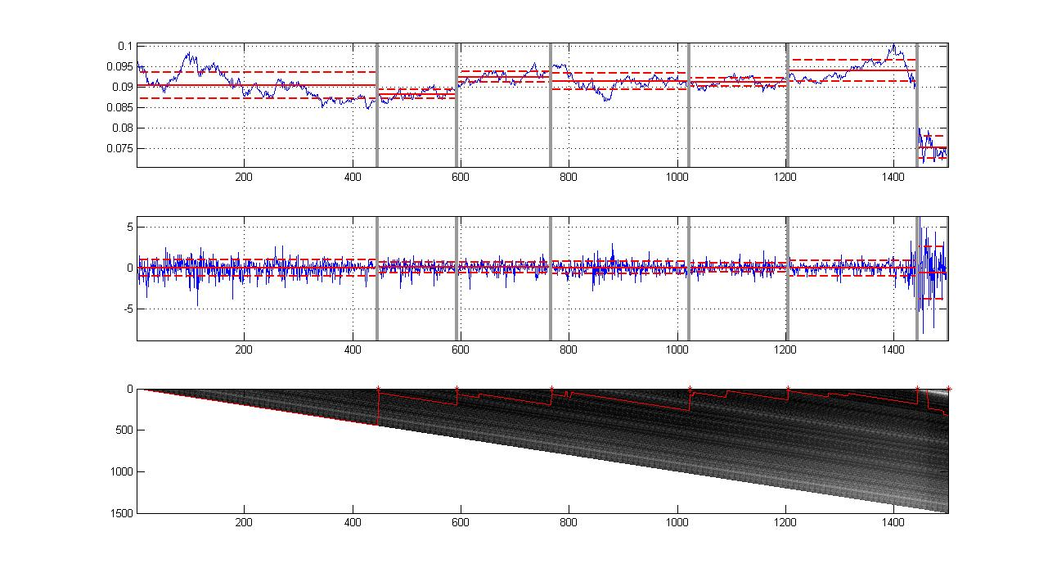
Example Output

Slide 36
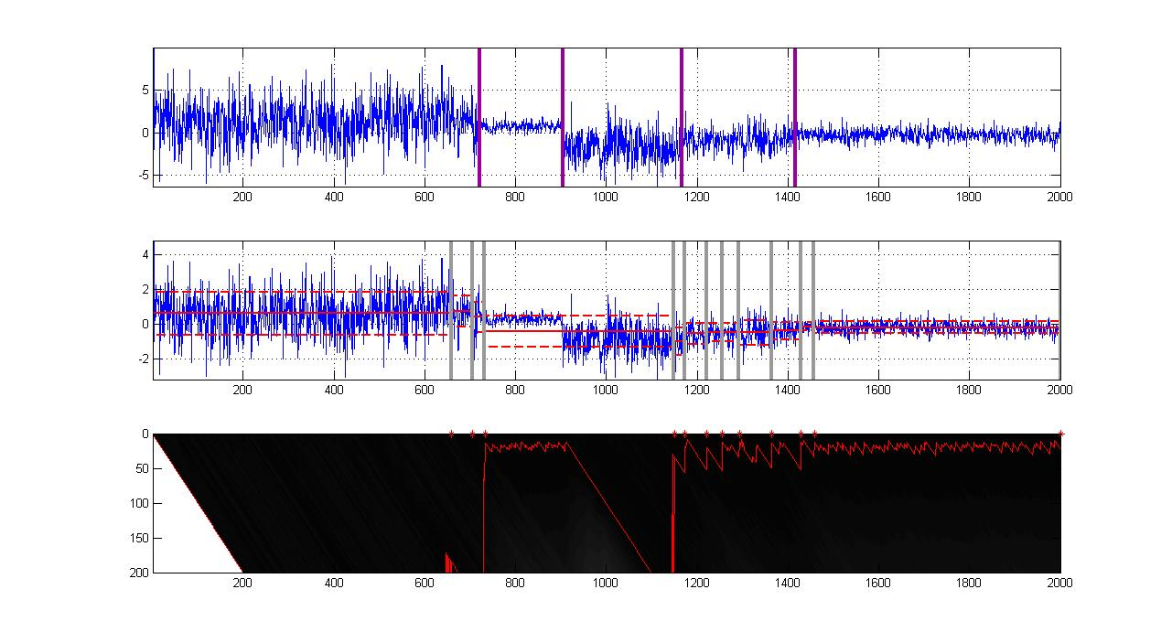
BOL synthetic data performance

Slide 37
Overall conclusions
Three problem approaches identified.
In addition, some other ‘leads’ are being followed. (use of HMM² and higher order Markov chains → non geometric duration times).

