Slide 1
One designated point of the Belt and Road Initiative --Sri Lanka
Speaker: Ir. Chris Lau
Director, Zhen Hua Engineering Company Limited
Deputy General Manager of Business Development Department, China Harbour Engineering Company Limited

Slide 2
Agenda
The involvement of Chinese Enterprise in development of infrastructure in Sri Lanka
The Infrastructure status of Sri Lanka
Projects executed by CHEC
Experience Sharing – Hambantota International Airport

Slide 3
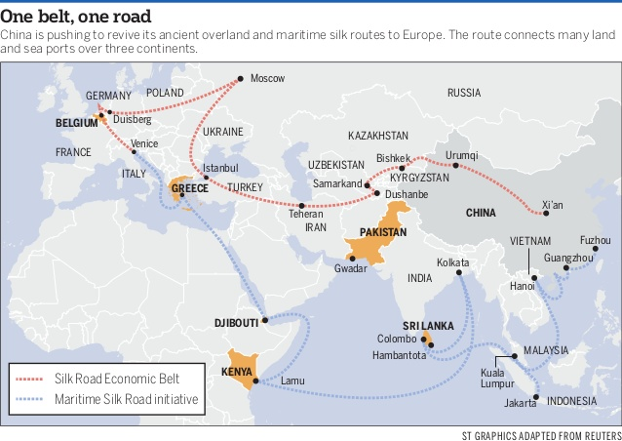
General Introduction of Sri Lanka - Geographical location in the Belt and Road Initiative
Most southern country in Indian Ocean
Island Country with Long coastline
Middle point of Marine Silk Road from China to Middle East and Africa

Slide 4
Foreign Investment Protection
The Board of Investment ("BOI") an autonomous statutory agency, is the primary government authority responsible for investment, particularly foreign investment.
Sri Lanka has signed investment protection agreements with 26 countries, including the United States (which came into force in May 1993).
Sri Lanka has entered into 28 Bilateral Investment Promotion and Protection Treaties (BITs) so far, providing a protection to foreign investments within the country.

Slide 5
The Involvement of Chinese Enterprise
Over the decade starting 2005-2015, China has emerged as the leading source of Official Development Assistance (ODA) and Foreign Direct Investment (FDI) in Sri Lanka–$14 billion. Most of it is ODA in loans and grants–$12 billion in sectors like energy, infrastructure and services. There is private Chinese investment too–$2 billion and growing.

Slide 6
The Involvement of Chinese Enterprise
Sri Lanka and China, economic relations in particular have grown exponentially during the last decade. China has become a significant economic partner of Sri Lanka. The Belt and Road Initiative (BRI) is closely connected with this. China has invested large sums of money to develop infrastructure (mega projects) and trade routes for what it believes is a mutually beneficial programme. Some of the BRI projects in Sri Lanka include ：
Colombo Port City Development Project, one of the largest FDI project in Sri Lanka to date；
Hambantota Port and Adjoining Industrial Estate, Colombo Port Expansion；
Hambantota International Airport； and
other infrastructure developments such as Norochcholai Coal power plant, Colombo-Katuanyake Expressway, Moragahakanda Project etc.

Slide 7
The Involvement of Chinese Enterprise (Hong Kong)
Private Chinese investment largely from Hong Kong billionaires & their Enterprise:
Lai Weixuan’s AVIC International Hotels Lanka
$250 million in luxury housing in Colombo
Robert Kuok’s Shangri-La Hotels Lanka
$16 million in a five-star hotel in Colombo
Li Ka-Shing’s Hutchison Telecommunication
$20 million on improving its mobile network in Sri Lanka.

Slide 8
The Infrastructure Status of Sri Lanka

Slide 9
The Condition of Infrastructure of Sri Lanka at Year 2020
Three International Airports, Capacity of annual passenger turnover(2019) is 9,975,151Mn
Three International Terminal- 7.2Mn TEUs total capacity
New constructed and operate enclosed highway
Colombo –Matara Expressway-126km
Outer Circular Expressway – 29km
Colombo – Katunayake Expressway – 25.8km
Colombo – Kandy Expressway – 98.9km

Slide 10
The Condition of Infrastructure of Sri Lanka at Year 2020
Five Star Hotels - such as Colombo Shangri-La :541 rooms capacity / Ahungalla RIU hotel-500 rooms capacity etc.,
Land Development – Port City 269 hectares

Slide 11
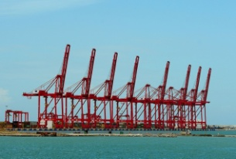
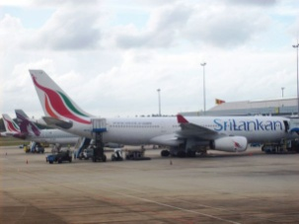
The Infrastructure Status of Sri Lanka
The Sri Lankan government has declared its intention to develop the country as a leading regional aviation, navigation and trading hub in South Asia. Therefore, the development of maritime & aviation transportation is at the forefront of the government's infrastructure development agenda. The focus of these developments is to expand the capacity and improve the efficiency of existing ports through modernization and construction of new ports and airports in strategic locations.
Port
Sri Lanka has deep-water ports at Colombo, Hambantota, Galle, and Trincomalee. Of these, Colombo handles the highest volume of cargo.
Airport
Sri Lanka's international airports include Colombo Bandaranaike International Airport, Mattala Rajapaksa International Airport and the under-renovation Ratmalana International Airport.

Slide 12
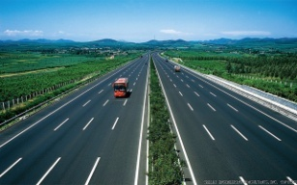
The Infrastructure Status of Sri Lanka
The national Road Master Plan has already been prepared, which focuses on the construction of highways, widening of highways, reduction of traffic congestion, road maintenance & rehabilitation and bridge rehabilitation & reconstruction.
It has become an urgent necessity for further investment in road network, thus the development of road network has become a major determinant factor in attracting new investments to the country.
Highway
Road transport accounts for about 93 per cent of the land transport in Sri Lanka. Sri Lanka's road network consists of 35 A grade highways and two Controlled-access highways (E01)and(E03).

Slide 13
Involvement of Infrastructure by Chinese Enterprise

Slide 14
The Colombo Port City
Sri Lanka’s is keen to make Colombo Port City the financial hub of South Asia as well as an international offshore financial center.
The new mini-city will be built entirely on 233 hectares of land reclaimed from the sea, stretching out from the coastline to the north of Colombo's famed Galle Face Green, an old colonial recreational ground.
On 11 November 2013, the China Communications Construction Co., Ltd. and the Sri Lanka Investment Authority signed the CCCC Port City Colombo investment agreement at Colombo.
The total investment is estimated to be about 1.4 billion US dollars, and a project duration of 3 years.

Slide 15
Hambantota Port
The port is expected initially to function as a service and industrial port and later be developed to handle transshipment cargo. The port is ideally located to serve the main East-West shipping lane connecting Europe and the Middle-east with South East Asia.
Contract Value:
Phase I: US$ 352million
Phase II: US$ 810million

Slide 16
Colombo South Container Terminal
Mattala Rajapaksa International Airport (MRIA) is an international airport serving southeast Sri Lanka. It is located in the town of Mattala, 18 km from Hambantota. It is the first greenfield airport and the second international airport in the country.
In 2011, China Merchants Port Holdings Company Limited(CMPH) signed a 35 year Build Operate and Transfer Agreement with Sri Lanka Ports Authority(SLPA) on the Colombo South Container Terminal with a 2.4 million TEUs capacity. CMPH holds 85% of the partnership whilst the balance 15% is being held by SLPA.

Slide 17
E03 expressway
Colombo - Katunayake Expressway E03 is Sri Lanka's second E Class highway. Construction on the highway began in October 2009, and it was opened in October 2013. The highway is 25.8km Long and has three lanes with the width ranging from 26 to 33.5 meters .
The total cost of the project is US $292 million. Exim Bank of China funded US$248.2 million of the total cost.
The contract was awarded to China Metallurgical Group Corporation (MCC) by the Government of Sri Lanka and the agreement was signed on 17 August 2008.

Slide 18
CHEC Experience in Sri Lanka

Slide 19
The Involvement of CHEC
The development of infrastructure has been a striking achievement in the post-war period. Improvement and development of the road network, increasing power generation, the construction of bridges, development of ports and the improvement of railways have been an important aspect of economic development in the last years.
As a leading PRC construction company, China Harbour Engineering Company (CHEC) has been involved in many infrastructure projects and currently is responsible for two mega-projects in Sri Lanka, Colombo Port City Development Project and Hambantota Port project.

Slide 20
China Harbour Engineering Company Introduction
China Harbour Engineering Company (CHEC) is part of China Communications Construction Company Limited (CCCC).
Incorporated in 2006, CCCC is listed on the Hong Kong and Shanghai Stock Exchanges and currently employs over 120,000 employees, with presence in 145 countries and regions.
CCCC is the world leader in port design and construction, road and bridge design and construction, dredging, container crane and heavy machinery manufacturing. In addition, CCCC is also vastly experienced in building construction and is a major real estate investor and developer.

Slide 21
The Belt and Road Initiative- Colombo Port City Project
Employer: CHEC Port City Colombo (Private) Ltd.
Contract Amount: USD 688Mn (Breakwater, Channel, Reclamation and Ground Treatment). Total Investment 1.4 Billion USD.
Date of Completion: 18 June 2019 (Phase I- Infrastructure works)

Slide 22
The Belt and Road Initiative- Colombo Port City Project
Construction Scope:
Dredging and reclamation of area 269ha.
Offshore breakwater 3245m, inner breakwater 473m.
Submerged groyne 430m.
North sand barrier 400m, South sand barrier 277m.
Revetments 8793m and the ground improvement works.

Slide 23
The Belt and Road Initiative- Hambantota Port Development Project Phase II
Employer: Sri Lanka Ports Authority
Location: Hambantota
Contract Amount: USD 808Mn
Date of Completion: May 2018
Construction Scope:
2 100,000 DWT General Terminal
2 100,000 DWT Container Terminal
1 100,000 DWT Oil Terminal
Channel dredging
400,000 m2 Artificial Island
Access Road
900,000 m2 Yard
Ancillary Equipment
Ancillary Buildings

Slide 24
Hambantota International Airport
Mattala Rajapaksa International Airport (MRIA) is an international airport serving southeast Sri Lanka. It is located in the town of Mattala, 18 km from Hambantota. It is the first greenfield airport and the second international airport in the country.

Slide 25
Southern Transport Development Project Package 1
Southern Transport Development is the first highway project as required by Sri Lanka’s City Overall Development Strategy. It is located southwest of Sri Lanka with a overall length of 120km connecting the capaital Colombo and the second largest city Galle. The roadbed is gravel cushion and the pavement is asphalt concrete. The standard width of the pavement is 20.5m and is designed to have dual 2-lane carriageway and to allow for a possible upgrading to dual 3-lane standard in the future. This project comprises the design and construction of Package 1 funded by JBIC. The total length is 34.5km starting from KOTTAWA 20km south of Colombo to Dodangoda.
Contract Value: US$ 250million

Slide 26
Trincomalee Integrated Infrastructure Project
AFD funded Trincomalee Integrated Infrastructure Project
Rehabilitation of Thirukkondiadimadu – Trincomalee Section of Trincomalee – Batticaloa Road, Allai – Kantale and 11.9km of Coastal Road.
Contract Value:US$ 69.2million
The work includes rehabilitation of approximately 175km of roads, and design & reconstruction of five bridges located between Thirukodiyamadu and Trincomalee. Length of the two longest bridges named “Upparu Bridge” and Gangei Bridge” are 350m and 250m respectively.

Slide 27
Colombo South Container Terminal Project
This Project is located at Colombo, capital of Sri Lanka. The scope of work will be the design, procurement and construction of a new facility adjacent to the existing Colombo Port, within the breakwater which is currently under progress. It mainly comprises of 1200m long quay structure using the gravity caisson structure, with 3 berths and a minimum alongside water depth of -18.0m lowest for accommodation of vessels from 18,000 DWT vessels to super post Panamax 175,000 DWT vessels. Dredging of the 2 million m2 harbour basin to a minimum depth of 18m.The expected annual throughput capacity of the South Container Terminal will be 2.4 million TEUs.

Slide 28
Mahinda Rajapaksa International Cricket Stadium
Hambantota International Cricket Stadium was built for the 2011 Cricket World Cup and hosted two matches. It has a capacity of 34,300 people and the building area is 22,000m², which includes: Grand Stand(5 levels), Media Center(5 levels), East and West Stand, Main Entrance, Public Entrance, Parking Lot, Practice Pitch.

Slide 29
Developing Countries – Humanity
Local Culture
Religious Belief
Discipline
Value of Lives

Slide 30
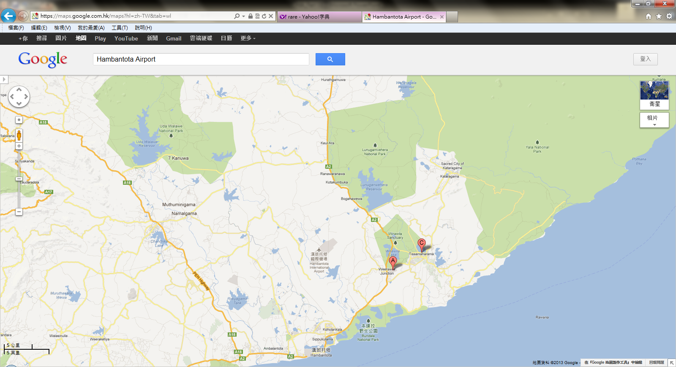
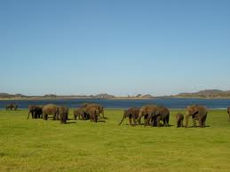
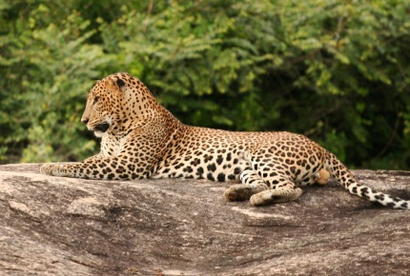
Experience Sharing – Hambantota Airport
Wildlife
The location of the project is a remote area surrounded by internationally recognized Wild Life Preserve. It is important to Design and Build the infrastructure with due care and in harmony with the environment.
In Hambantota Airport design, Grading & Site Formation, Drainage, and Earthwork Balanced were planned in a decent manner to minimize the impact to the surrounding environment. Soft landscaping are provided as original scope of the EPC proposal as well.

Slide 31
Experience Sharing – Hambantota Airport
Vision and Value
Creating the greatest value for our clients, Establishing win-win cooperation, Fulfilling both commercial and social responsibilities.
It would be difficult to make progress without the joint effort among the involved parties in a projects like the HIA.
Always maintain the communication channel and take opportunity for further coordination.

Slide 32
Experience Sharing – Hambantota Airport
Resources
Design and build Greenfield Airport to land Code F aircraft is very tight within 36 months
Introduce the International and Chinese Consultants, Contractors and Suppliers for those the critical infrastructures or elements with implication to the Airport operation.
Social responsibility and benefit to the country, recruit services local sub-contractors, consultants, especially labour forces in the region
Remote location, challenging of sources of those back-up facilities such as power, fuel line, telecom, internet, etc., in the early stage. Proper planning and temporary provision is essential in managing project in this situation.

Slide 33
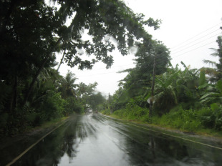
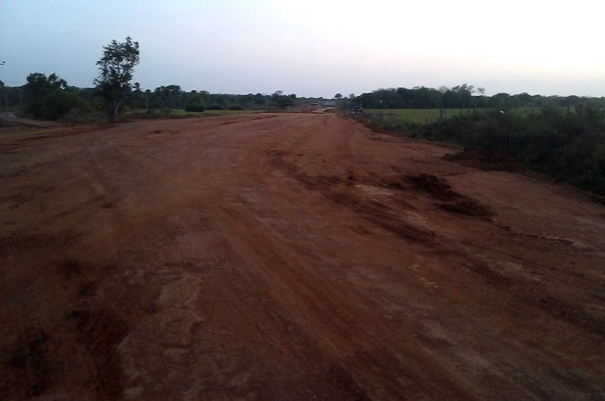
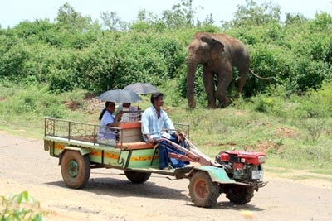
Experience Sharing – Hambantota Airport
Logistic
Transportation through the existing road network is a big challenge. Construction materials, labour forces, plant and equipment were all taken to the site in the roadway similar to the photos below.
Type of vehicles, fuel supply, plant and equipment chosen, maintenance schedule, etc., have to be well-organized based on the CHEC’s experience in the local market.

Slide 34
Experience Sharing – Hambantota Airport
Training:
The presence of professional and consistent project management team is the key to continuously perform and to success in the construction industry.
Train up the young engineers and seconded professionals, originated from different background and culture is very important. Organizing and reinforcing the team in such a manner will be beneficial to the company beyond one project level.
Standardize the Quality Management System and other management tools is very important.

Slide 35
Developing Countries – Life Style of stationed abroad
Safety in work, safety in living
Catering, Shelter and Transport
Self Discipline,
Group activities
Privacy

Slide 36
The End

