Slide 1
Port Development in Sri Lanka
Tissa Wickramasinghe
Chief Operating Officer
Hambantota International Port Group

Slide 2
Introduction to Ports in Sri Lanka
Port of
KANKASENUTHURAI
Port of
TRINCOMALEE
World’s second largest Natural Habour
Traffic in 2020
Cargo: 3 million Tonnes
Ships Arrived : 135
Largest commercial port in the country with most traffic
Traffic in 2020
Cargo : 98 million Tonnes
Ships Arrived : 3,806
Port of
OLUVIL
Port of
COLOMBO
Newest port in the country
Traffic in 2020
Cargo : 2 million
Ship Arrived : 464
A Natural Habour
Traffic in 2020
Cargo : 0.4 million Tonnes
Ships Arrived : 22
Port of
GALLE
Port of
HAMBANTOTA
Major Ports
Minor Ports

Slide 3
Port of Colombo – Gateway to South Asia
22nd Ranked Port in the world
15th in global port connectivity index
8+ million TEUs Capacity
90% capacity utilization
Berth occupancy 65%+
Immediate plan for 12+ million TEUs capacity
35+ million TEUs capacity in 2035
Already achieved the UNCTAD congestion level
Most connected port in the South & West Asia
50% capacity addition within next 36 months in phases
15% SLPA
15% SLPA
15% SLPA

Slide 4
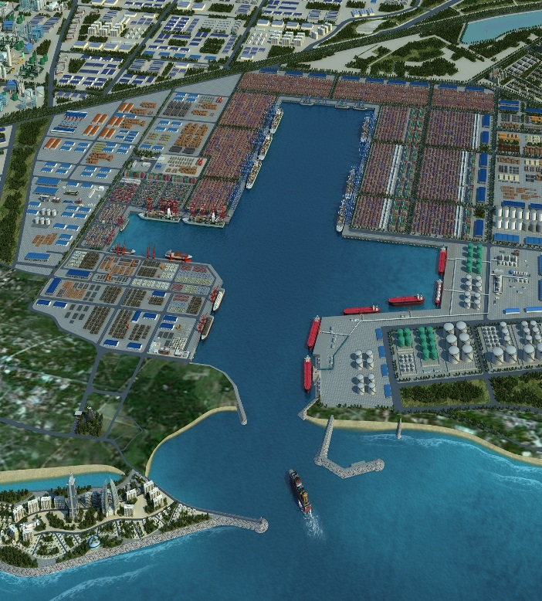
Hambantota International Port– Pivot of the East and West
Ideal multi-cargo deep water Port of Choice
Current capacity of handling container vessels of 10,000 TEUs
Low Sulphur fuel oil is available for bunkering
Marine Services
Berth Occupancy 50%+
Industrial zone with 330 Ha of land
Port-Park-City model
Industrial Zone
Phase in
the Future
Phase II
Industrial Zone
Phase 1
Phase 1

Slide 5
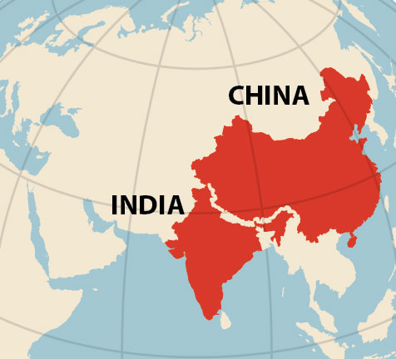
Sri Lanka – South Asia’s Hong Kong
With an over 7,500-km-long coastline spread across nine coastal states, four union territories (UTs) - including two island UTs, 12 major, and 200 minor ports
184 TEUs/ `000 people
Population - 1.44 billion
Geographically Sri Lanka is located in the middle of the Indian Ocean, with hubs from either sides and well positioned to cater South Asia as a hub
Government of India has taken several initiatives to promote a healthy environment for the growth of manufacturing sector in the country. With its large population and current volume output, India has a great potential to expand itself as a major manufacturing nation.
12 TEUs/ `000 people
Population - 1.38 billion
Hong Kong
Sri Lanka

Slide 6
Introduction of PPP model for port development in Sri Lanka PPP – Project Summary
First PPP terminal project in Sri Lanka
SAGT
01
P&O Ports and John Keels Holdings JV for expansion of existing QEQ terminal to handle 1 million TEU. A $240 million investment for a 30-year BOT Project
The project got off ground in 1999 and was completed in 2003
The largest terminal in the POC and the first terminal in South harbour
02
CICT – the first deep-water terminal BOT bid was awarded to CMPORT through a global tender
GOSL followed the process as per the guidelines of the ADB who funded the breakwater
CICT
Newest Port in the country located on the main east west shipping route
HIPG/HIPS
03
The HIPG – PPP was done without calling for public bids, as there was a formal G to G agreement in place – even with such a situation, the GOSL called for two separate competing bids from two different organizations identified by the GOC – in addition the GOSL has the right to buy back 20% shares within 10 years, which will in effect in crease the GOSL equity to 35%
Much delayed – Finally SLPA to run
Equipment order cancelled in 2015
PPP project launched with ADB assistance.
7 parties short listed in 2016
Abandoned in favor of partnership with India Japan -G to G agreement
04
ECT
3rd Terminal to be constructed in the South harbour
WCT
05
GOSL is following the same principle in handling the PPP of the WCT in the POC, as there is a MOC with the GOI / JAPAN ( IE: no public bids have been called) – but in this case the GOI recommended just one company and as such the GOSL lost out on the potential advantage of having two competing bids

Slide 7
CICT Project – Bidding Process
2006-2009
2009-2010
2011
2013
2014
2007
Selection
Ground Breaking
Operations Started
5 proposals received from bidders
Completion
Only one proposal was received and it was from CMPort-Aitken Spence consortium
CMPORT Investment - US$ 500 million
Groundbreaking ceremony of the first deepwater terminal in Sri Lanka and South Asia
First phase of the terminal operation started.
Strategically project/Sri Lanka was ready for the global demand
The first deepwater terminal was ready in record 28 months, giving an advantage of 32 months (planned for 60 months)
Placed Sri Lanka back on the maritime trade map as a strategic hub for container operations
2008
Cancelled the RFP process
2009
Re-invited for proposals. 15 potential bidders collected the docs.
As per the ADB guidelines
The first RFP was cancelled after the technical evaluation.
The delay in selection affected the effectiveness of ADB loan & loan Agreement signed by GOSL includes the condition allowing ADB to suspend the loan, in the event GOSL failed to award the Container Terminal Concession within 18 months from May 2008.
ADB condition was that the first two terminals within the south harbour must be run under the PPP process and one terminal can be run by the SLPA.
Later it was changed from first two terminals to any two terminals by SLPA

Slide 8
Hambantota Project – Investment Structure
CMPort
SLPA
HIPG
HIPS
HIPG
Hambantota International Port Group (Pvt.) Ltd.
Business development
HIPS
Hambantota International Port Services (Pvt.) Ltd.
Port services provider

Slide 9
CICT – HIPG Volume Analysis
2
1

Slide 10
Challenges & Opportunities
Sri Lanka’s strategic location
Policy
Container & Energy Hub
Competitive landscape
Best performing levels
Mega terminal facilities
National Maritime Policy
SLPA;
Landlord/regulator/competitor
Interest from top customers
Opportunities
Funds
Most of the top shipping lines focuses the development of South & West Asia around Colombo
Challenges
Lack of Funds
Maritime and logistics hub in Asia.
Capacity crunch
Potential of developing as one stop shop by developing quality ancillary services, and ease of doing business
Slow progression in capacity addition

Slide 11
Thank You !!

